Slide 1
Mini Project on Topic - Restaurant Billing System
Developed by-
Yash Garudkar
Minaz Inamdar
Ratna Phalak
Mohit Sonawane
Guided By-
Prof. Anirudha A. Kolpyakwar

Slide 2
TABLE OF CONTENTS
Problem Statement
Introduction
Motivation
Related Work
Program Architecture
Working Methodology
Results
Conclusion
Futurework
References

Slide 3
PROBLEM STATEMENT
The businesses in restaurants are now growing constantly.
The need for managing restaurant operations and tasks arises.
The best way to optimize these activities is building an easy interface on computer to make these backend activities easier to handle.
RESTAURANT BILLING SYSTEM is Desktop Application to restaurant management.
This system provides solution to restaurant and owners automate their BILLING OPERATIONS.

Slide 4
INTRODUCTION
The following project details python project for Restaurant Billing System in Python language.
To keep the order and calculations easy. This system provides cohesion between the restaurant floor and back office.
Waiters have an easy interface they can use to take orders, the order then shows up on an interface for the kitchen staff to complete.
The manager can use another interface to edit the menu, generate reports/analyze statistics, and perform stock control.

Slide 5
MOTIVATION
The Sole Motivation for the project is to learn the application development in python, how python application works to produce more simple and effective commercial applications for daily business.

Slide 6
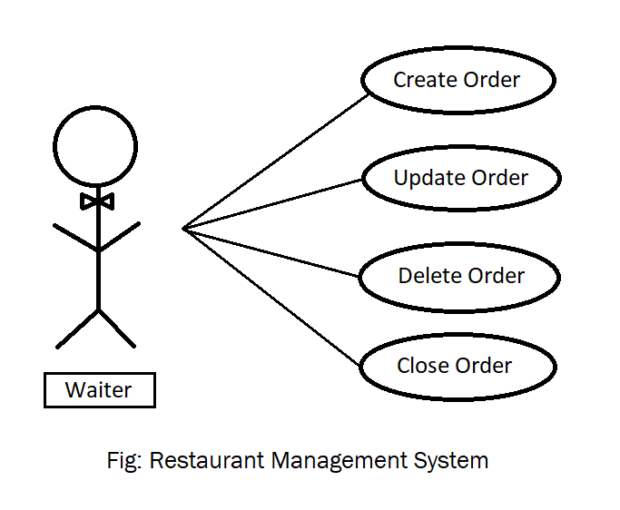
PROGRAM ARCHITECTURE

Slide 7
WORKING METHODOLOGY
Working Methodology makes a large effect on the system so we chose programming with Python because of its reliability and suitability to the architecture.
PYTHON-
Python is easy-to-maintain, portable, scalable, supports GUI applications and provides interfaces to databases.
Python GUI (Graphical User Interfaces)-
Tkinter -Tkinter is the standard GUI library for Python.
Python when combined with Tkinter provides a fast and easy way to create GUI applications.

Slide 8
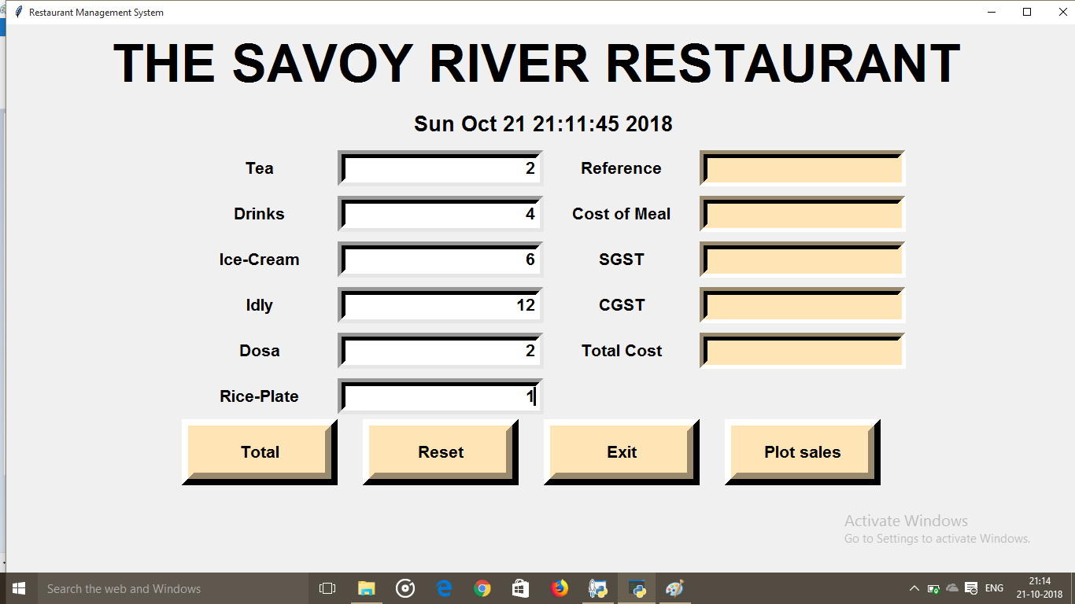
RESULTS: Main Display (Window Snapshot 1)
GUI- Main display window with name of restaurant name current time and date with calculator

Slide 9
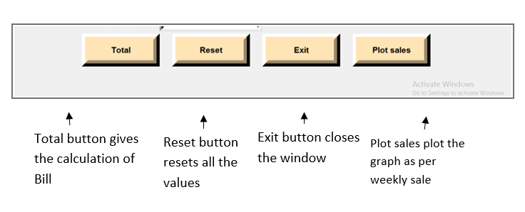
RESULTS: Buttons (Snapshot 2)

Slide 10
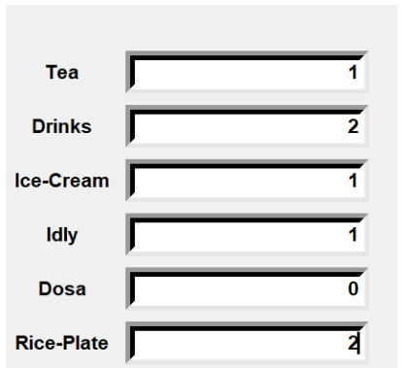
RESULTS: Number of items (Snapshot 3)
We need to insert number of menu items taken by customer ,after inserting no. of items

Slide 11
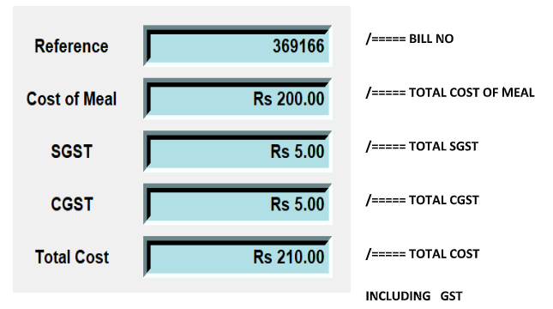
RESULTS : Generated Bill (Snapshot 4)

Slide 12
RESULTS : Final Bill (Snapshot 5)
After clicking ‘Total’ button it will automatically generate the bill.

Slide 13
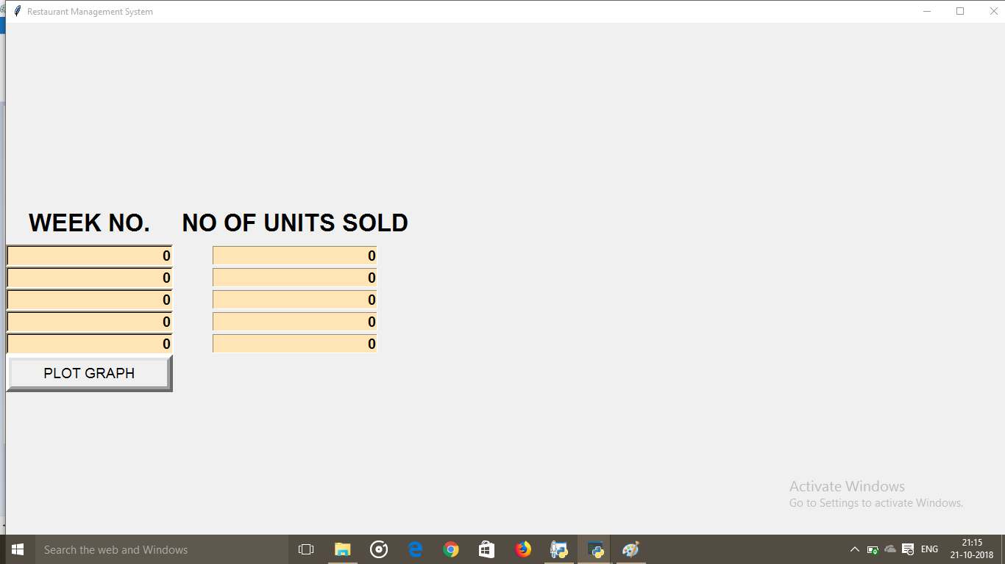
RESULTS : Graph Plot
After clicking ‘Plot sales’ this window will generate.

Slide 14
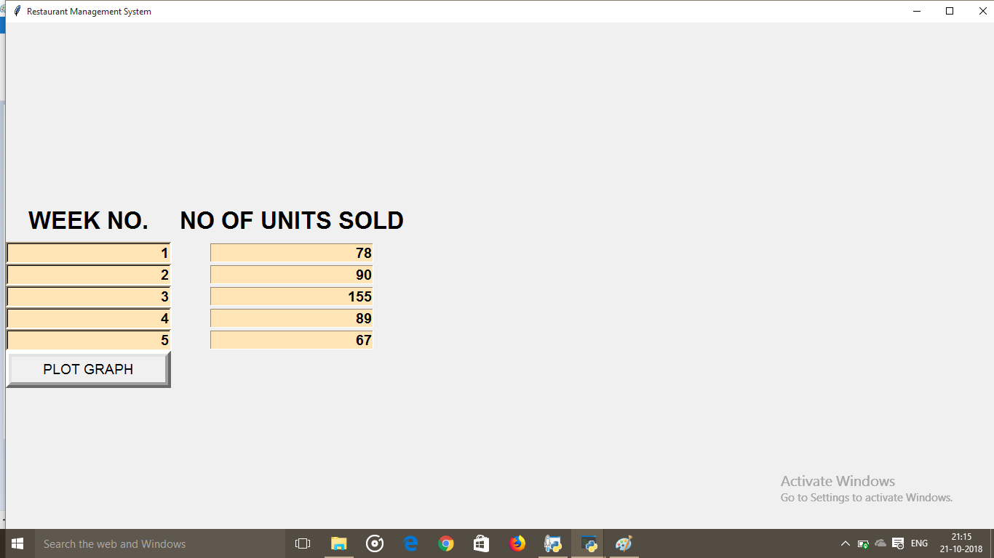
RESULTS : Filling Details
In this popped up window we fill the weekly sales in INR(Indian Rupees).

Slide 15
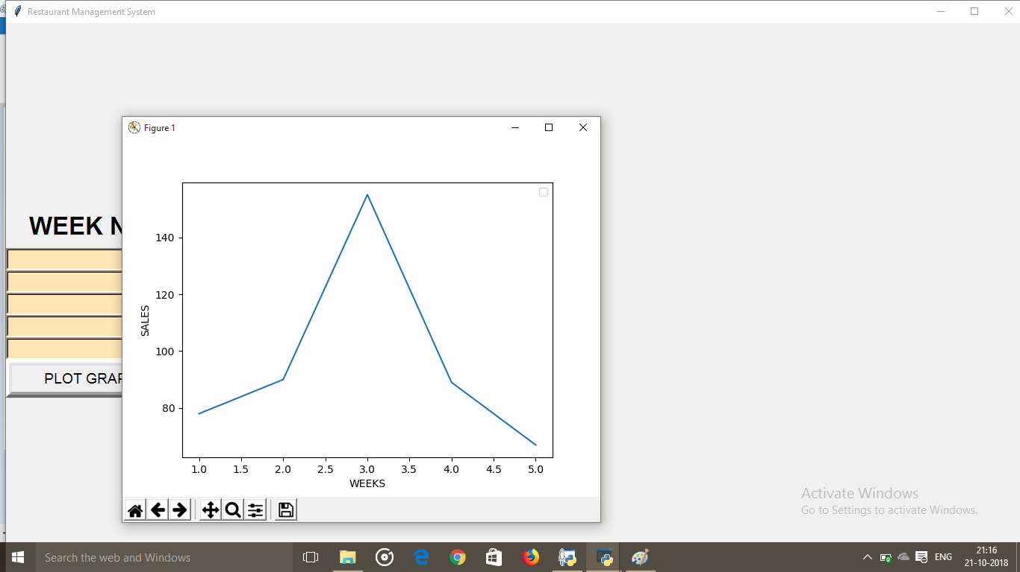
RESULTS : Plotted Graph
After clicking on ‘PLOT GRAPH’ the final graph of SALES x WEEKS will be plotted.

Slide 16
CONCLUSION
This project has really been faithful and informative.
It has made us learn and understand the many trivial concepts of Python Language.
As we have used python Tkinter as a GUI it provides various controls, such as buttons, labels and text boxes to build a user friendly application.
The fast growing use of internet confirms the good future and scope of the Restaurant Management System.
Finally it has taught us a valuable lifelong lesson about the improvements and working and interacting in a group.

Slide 17
FUTUREWORK
Improvements in the future could include an integrated iOS application, which would allow customers to order food directly from their own phones. The system could let customers create reservations on their phones On the fly payments can be implemented in iOS and Mobile devices to allow staff to take payments at the table, similar to the system used in Apple Stores.
A feature which enables chef’s to inform waiters about specials and food items that are out of stock can be implemented.

Slide 18
REFERENCES
[1] Inamo Restaurant using E-TABLE System [Online] Available at:
http://www.inamo-restaurant.com/index.php
[2] E-‐TABLE [Online] Available at:
http://www.e-table-interactive.com/
[3] Eating out in modern American society: Why do people make the choice to eat outside the home? [Online] Available at:
https://library.uvm.edu/jspui/bitstream/123456789/233/1/Epter%20Thesis.pdf
[4] Does a Restaurant Need a Point of Sale System? [Online] [Video] Available at:
https://www.youtube.com/watch?v=c7ELx2BLeWo

Slide 19
THANK YOU!

